Slide 1


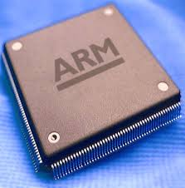
Microprocessor & Computer Architecture UE17CS253
UNIT-3
Session – 4
Cache Performance

Slide 2
Performance considerations
A key design objective is to achieve the best possible performance at the lowest possible cost.
Price/performance ratio is a common measure.
Performance of a processor depends on:
How fast machine instructions can be brought into the processor for execution.
How fast the instructions can be executed.
Memory hierarchy described earlier was created to increase the speed and size of the memory at an affordable cost.
Data need to be transferred between various units of this hierarchy as well.
Speed and efficiency of data transfer between these various memory units also impacts the performance.

Slide 3
Performance enhancements - Prefetching
New data are brought into the processor when they are first needed.
Processor has to wait before the data transfer is complete.
Prefetch the data into the cache before they are actually needed, or a before a Read miss occurs.
Prefetching should occur (hopefully) when the processor is busy executing instructions that do not result in a read miss.
Prefetching can be accomplished through software by including a special instruction in the machine language of the processor.
- Inclusion of prefetch instructions increases the length of the
programs.
Prefetching can also be accomplished using hardware:
- Circuitry that attempts to discover patterns in memory references and then prefetches according to this pattern.

Slide 4
Performance enhancements - Lockup-Free Cache
Prefetching scheme does not work if it stops other accesses
to the cache until the prefetch is completed.
A cache of this type is said to be “locked” while it services a
miss.
Cache structure which supports multiple outstanding misses
is called a lockup free cache.
Since only one miss can be serviced at a time, a lockup free
cache must include circuits that keep track of all the
outstanding misses.
Special registers may hold the necessary information about
these misses.

Slide 5



Cache Performance
The Processor Performance Equation

Slide 6
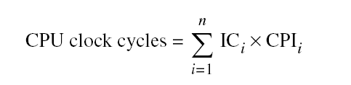
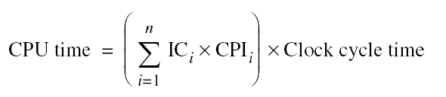
Cache Performance
Different instruction types having different CPIs
One method to evaluate cache performance is to expand processor execution time.
Add memory stall cycles - the number of cycles during which the processor is waiting for a memory access.
CPU Execution = (CPU clock cycles + Memory stall cycles) x Clock cycle time
time

Slide 7
Cache Performance
Equation assumes that CPU clock cycles include
The time to handle a cache hit.
The processor stalled during the cache miss.
The number of memory stall cycles depends on
The number of misses
The cost per miss
This is called Miss penalty.
Memory stall cycles = Number of misses x Miss penalty.
= IC x Misses x Miss penalty.
Instructions
= IC x Memory Accesses x Miss Rate x Miss penalty
where, Instructions
Miss rate = Cache access that result in a miss.
=> ( # of access that miss )
( # of access)
Note: miss rates and miss penalties are often different for read & writes.

Slide 8
Cache Performance
Memory stall cycles can be defined in terms
Number of memory accesses per instruction.
Miss penalty ( in clock cycles for reads & writes)
Miss rate ( for reads & writes)
That is,
Memory stall = IC x Reads per instruction x Reads miss rate x Reads miss penalty +
clock cycles IC x writes per instruction x writes miss rate x writes miss penalty
Normally, simplifying the complete formula,
Combining reads & writes.
Finding the average miss rates and miss penalty for reads & writes.
= IC x Memory Accesses x Miss Rate x Miss penalty
Instructions
Note:
Miss rate is not the only most important measures of the cache design.

Slide 9
Cache Performance -Example 1
Assume we have a computer where the cycles per instruction (CPI) is 1.0 when
all memory accesses hit in the cache. The only data accesses are loads and stores, and these total 50% of the instructions. If the miss penalty is 25 clock cycles and the miss rate is 2%, how much faster would the computer be if all instructions were cache hits?
Ans: First compute the performance for the computer that always hits:
CPU execution time = ( CPU clock cycles + Memory stall cycles) × Clock cycle
= ( IC × CPI + 0) × Clock cycle
= IC × 1.0 × Clock cycle
Now for the computer with the real cache, first we compute memory stall cycles:
Memory stall cycles = IC × Memory accesses x Miss rate × Miss penalty
Instruction
= IC × (1 + 0.5) × 0.02 × 25
= IC × 0.75
where the middle term (1 + 0.5) represents one instruction access and 0.5 data
accesses per instruction. The total performance is thus
CPU execution time cache = (IC × 1.0 + IC × 0.75) × Clock cycle
= 1.75 × IC × Clock cycle

Slide 10
Cache Performance -Example 1
The performance ratio is the inverse of the execution times:
CPU execution time _{cache} = 1.75 × IC × Clock cycle = 1.75
CPU execution time 1.0 × IC × Clock cycle
Hence, The computer with no cache misses is 1.75 times faster.

Slide 11
Cache Performance -Example 2
Continued…….

